Slide 1

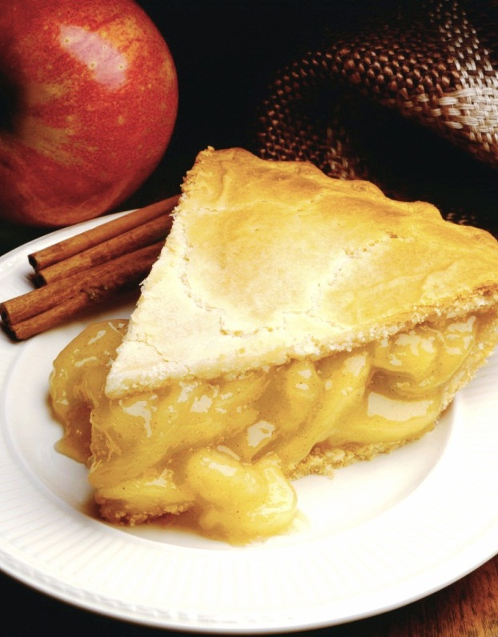
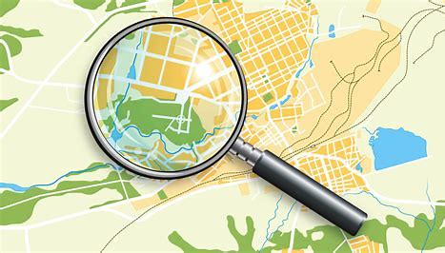
Fantastic Food Finder
Easily locate the best food options around you!
Notes:
NOTE: To replace a picture, just select and delete it. Then use the Insert Picture icon to replace it with one of your own!

Slide 2
Agenda
Overview
Features Deep Dive
Map
Nearby List
Galleries
Possibilities
Questions

Slide 3



The Team!
Prabh Singh
Luke Gallagher
Peter Rooney

Slide 4
Overview
Elevator Pitch
User Story
Motivation
Notes:
Elevator Pitch
The Fantastic Food Finder allows users to easily locate the best food options around them. It is a more accessible alternative to existing food finders in that it offers a simple interface and limited yet relevant information to users. Very briefly, users can search by pricing/rating, get access to 20 of the nearest restaurants and information on the Top 10 trending, cheap and romantic dining options.
User Story
AS A passionate foodie
I WANT to locate nearby restaurants
SO THAT I can make more informed decisions on where I can eat.
Motivation
Project requirement was to use multiple server-side API’s and we thought Maps JavaScript API in conjunction with Zomato would provide a good user experience.

Slide 5
Process
Breakdown of Tasks & Roles
API’s/Libraries used:
Maps JavaScript API Places Library (.textSearch service)
Zomato API (/collections & /search endpoints)
Swiper API (3D Cube Effect)
Challenges
Successes
Notes:
Breakdown of Tasks & Roles
Luke: Map
Prabh: Gallery
Peter: Search Form
Challenges
Using the users geolocation in google gave us a list of 20 restaurants. But, when we used the same coordinates in Zomato, it gave us a different list. Integration of google data with Zomato was not possible.
Other features of Zomato API were tested for implementation. Used /collections endpoint to

Slide 6
Demo
https://prabhm512.github.io/fantastic-food-finder/
Notes:
Search list
Scroll through nearby res list
Click on a res in the list
Click on the marker
Close information showing on map
The Nearby list gives names of 20 of the nearest restaurants. Clicking on these names relocates finder to the map. The address & rating on restaurants is shown as a popup on the map.

Slide 7
Can be used for explaining code
Step 1 Title
Step 2 Title
Step 3 Title
Step 4 Title
Step 5 Title
Class | Group A | Group B
Class 1 | 82 | 95
Class 2 | 76 | 88
Class 3 | 84 | 90

Slide 8
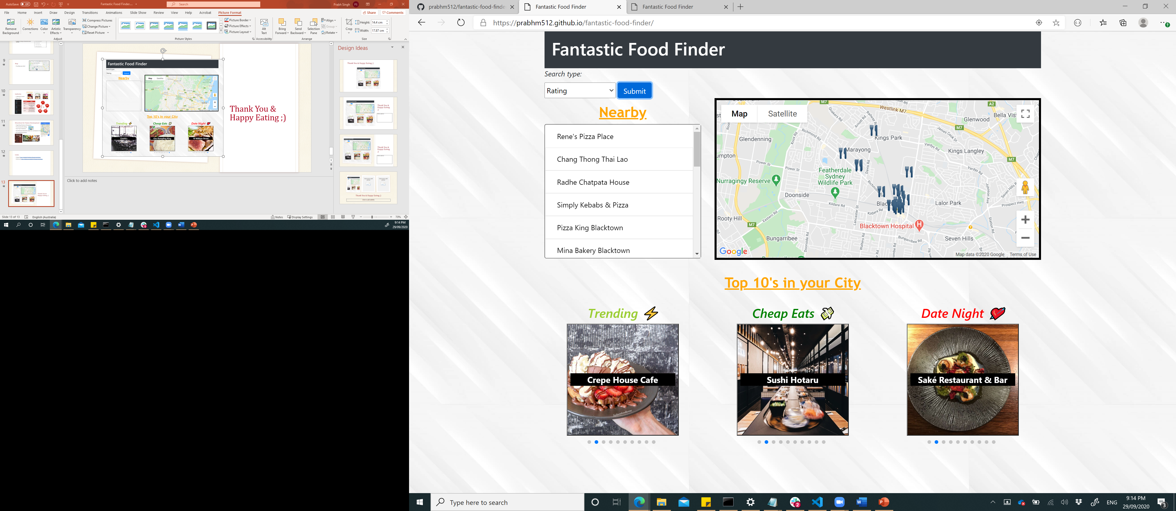
Nearby List
Sort by distance, price, rating
20 restaurants displayed
Scroll (Overflow of y-axis set to scroll)
Address & rating of restaurant shown on click.

Slide 9
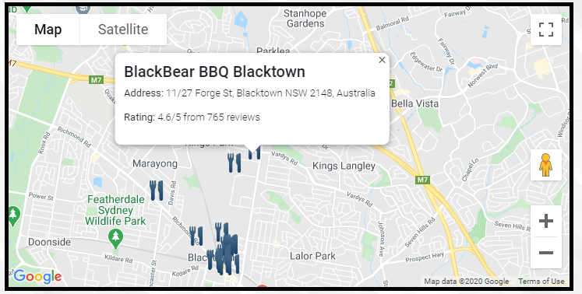
Map
Everything map related

Slide 10
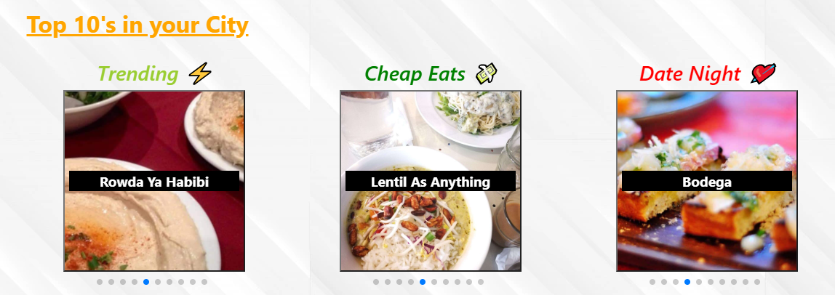
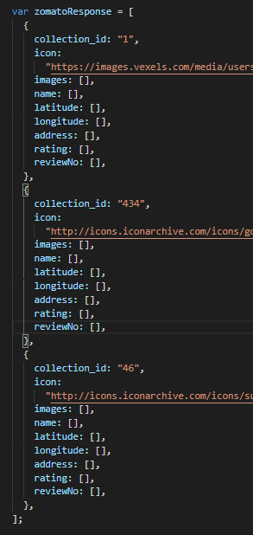
Galleries
/collection & /search
Swiper API
Variables | Roles
swiper | Holds swiper instance
slides | Holds images & names from Zomato API response
caption | Holds names from Zomato response
counter | Holds number so that each swiper slide can have a unique reference
AJAX call
New Swiper Instance
Push response to array
Render Swiper by calling array values
On Swiper click, load icon on map
3x

Slide 11
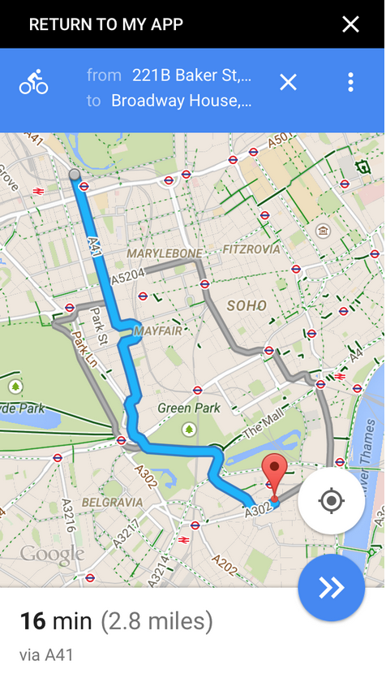

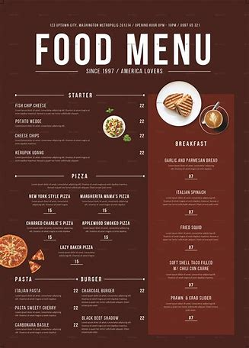
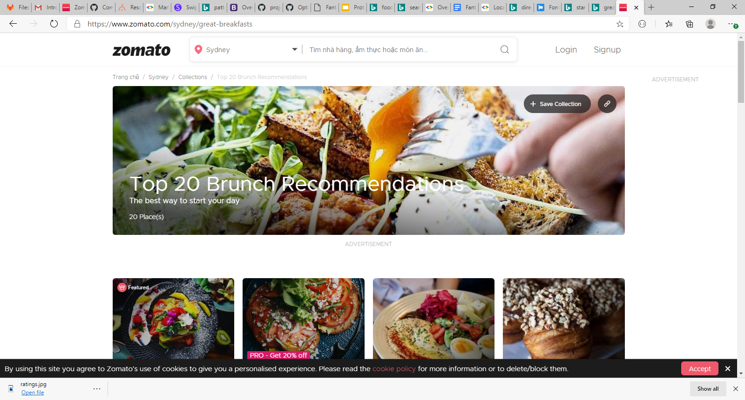
Directions for Future Development
Google Maps Directions API integration
Font-Awesome Star Ratings
More ‘Top 10’ Collections
More Restaurant Information (daily menu, opening hours etc.)
Sort Nearby list by distance

Slide 12
Links
Deployed: https://prabhm512.github.io/fantastic-food-finder/
GitHub repo: https://github.com/prabhm512/fantastic-food-finder

Slide 13
Thank You & Happy Eating ;)

